Slide 1
C# Basic Programming Constructs
Chapter 2 - Part 1

Slide 2
Lecture’s Scope
Data Types, Constants, and Variables
Making Statements in a Program
Working with Conditional Statements, and Loops
Working with arrays

Slide 3
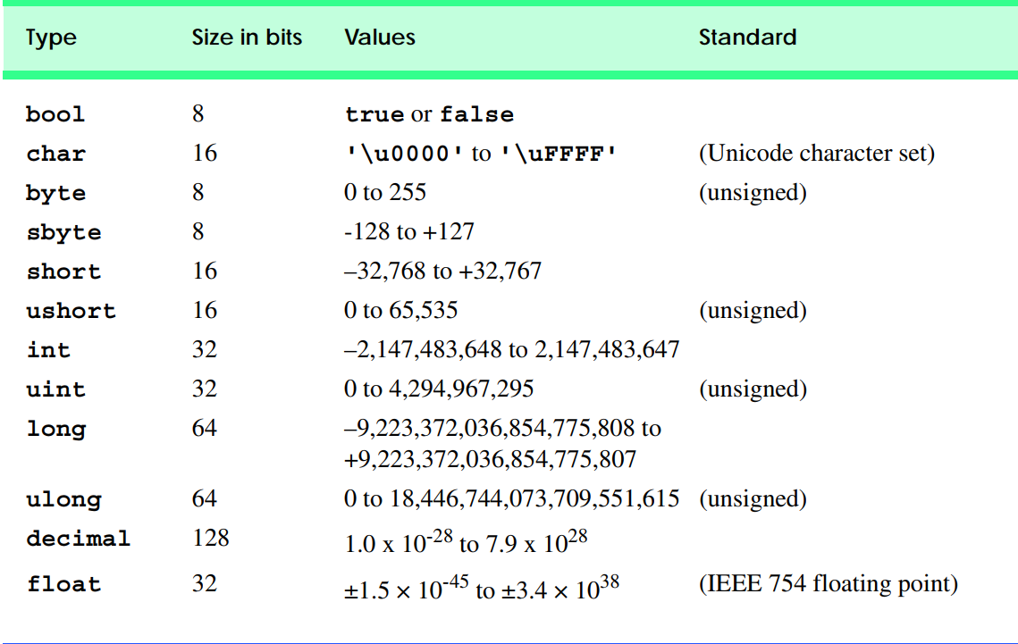
Data types in C#

Slide 4
Variables
For a computer program to process or manipulate data, the characters and numbers must be stored in random access memory (RAM).
Variables are the programming elements that facilitate this storage.
A variable represents an area in the computer memory where a value of a particular data type can be stored.
When you declare a variable, you allocate memory for that data item in your program.
Type identifier;
Type identifier = expression; //compile time initialization, the expression can be a value such as 0 or 27 or another identifier in arithmetic expression

Slide 5
Integer Types
Integer types represent integer numbers(they are like whole numbers but include negative numbers) and are sbyte, byte, short, ushort, int, uint, long and ulong. Let’s examine them one by one.
The sbyte type is an 8-bit signed integer. This means that the number of possible values for it is 2 the power of(8), i.e. 256 values altogether, and they can be both, positive and negative. Default value is 0.
The byte type is an 8-bit unsigned integer type. It also has 256 different integer values (2^8) that can only be nonnegative. Its default value is the number 0.

Slide 6
Cont.
The short type is a 16-bit signed integer. Its minimal value is Int16.MinValue = -32768 , and the maximum is Int16.MaxValue = 32767. The default value for short type is the number 0.
The ushort type is 16-bit unsigned integer. The minimum value that it can store is UInt16.MinValue = 0, and the minimum value is – UInt16.MaxValue = 65535. Its default value is the number 0.
Int It is a 32-bit signed integer. As we can notice, the growth of bits increases the possible values that a type can store. The default value for int is 0.

Slide 7
Cont.
The uint type is 32-bit unsigned integer type. Its default value is the number 0u or 0U (the two are equivalent). The 'u' letter indicates that the number is of type uint (otherwise it is understood as int).
UInt32.MaxValue = 4,294,967,295
The long type is a 64-bit signed type with a default value of 0l or 0L (the two are equivalent but it is preferable to use 'L' because the letter 'l' is easily mistaken for the digit one '1'). The 'L' letter indicates that the number is of type long (otherwise it is understood int). Int64.MinValue = -9,223,372,036,854,775,808 (-263) and its maximum value is Int64.MaxValue = 9,223,372,036,854,

Slide 8
Cont.
The biggest integer type is the ulong type. It is a 64-bit unsigned type, which has as a default value – the number 0u, or 0U (the two are equivalent). The suffix 'u' indicates that the number is of type ulong (otherwise it is understood as long).
UInt64.MinValue = 0 and the maximum is UInt64.MaxValue = 18,446,744,073,709,551,615

Slide 9
Real Floating Points
Real Floating Point
Float is also considered as single precision real number.
Its default value is 0.0f or 0.0F (both are equivalent).
The considered type has accuracy ranges from 6 to 9 decimal places (the others are lost).
For instance, if the number 0.123456789 is stored as type float it will be rounded to 0.12345679.

Slide 10
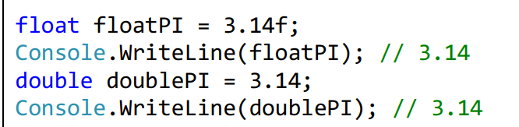
Cont.
Real numbers double (also known as double precision real numer)
Double is a 64-bit type with a default value of 0.0d and 0.0D (the suffix 'd' is not mandatory because by default all real numbers in C# are of type double).

Slide 11
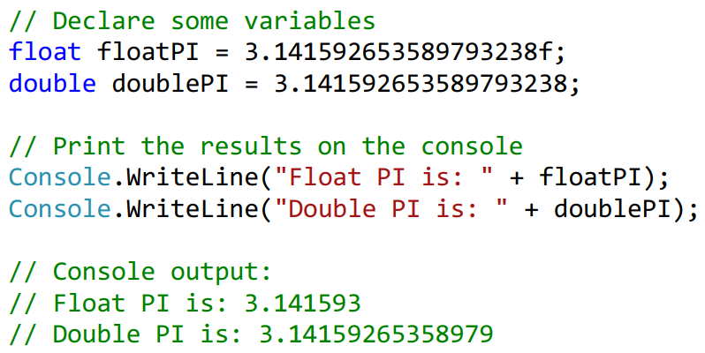
Float vs Double

Slide 12
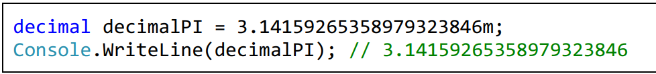
Real Types with Decimal Precision
C# supports the so-called decimal floating-point arithmetic, where numbers are represented via the decimal numeral system rather than the binary one.
The type of data for real numbers with decimal precision in C# is the 128-bit type decimal. It has a precision from 28 to 29 decimal places.

Slide 13
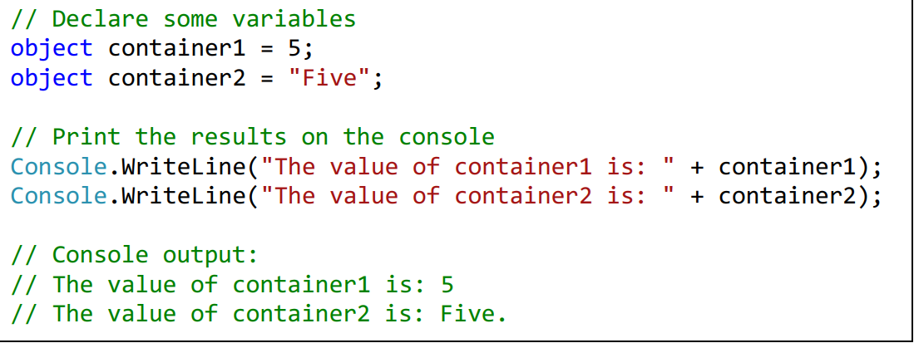
Object Type
Object type is a special type, which is the parent of all other types in the .NET Framework. Declared with the keyword object, it can take values from any other type. It is a reference type, i.e. an index (address) of a memory area which stores the actual value.

Slide 14
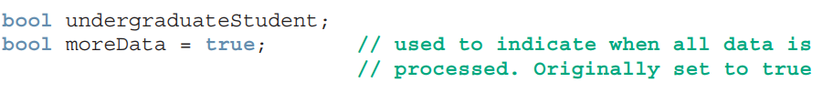
Boolean Type
Boolean is based on true/false, on/off logic.
Boolean inherits from the Value and Struct classes but not from the Numeric type.
The only Boolean type in C# is bool.
A bool variable can have a value of either true or false.
The bool type will not accept integer values such as 0, 1, or -1. The keywords true and false are built in to the C# language and are the only allowable values.

Slide 15
Character and String Types
The character data type
Represent symbolic information, declared by the char keyword: has a ‘\0’ default value.
char ch = ‘A’;
The String data type
Represent a sequence of characters, is declared by the string keyword: default value is null (no value)
string str = “Ruhama”;

Slide 16
Be aware of the following special cases when initializing data types:
When initializing a char, use single quotes surrounding the letter.
When initializing a string, use double quotes surrounding the text.
When initializing a value that includes the decimal point,
For a decimal type, follow the number with the letter M.
For a float type, follow the number with the letter F.
Under other special circumstances, you might be required to include letter values following the numeric values for other data types.

Slide 17
Keep in mind the following facts when declaring and initializing variables:
You can use either the C# keyword or the .NET Framework type to declare data types. For example both of the following lines declare a 32-bit signed integer variable named x, initialized to the value 5. System.Int32 x = 5; int x = 5;
You can also declare a variable using the new keyword as follows:
int x = new int();.
This syntax declares the variable and initializes it with the default value (in this case 0).
Multiple variables can be declared and initialized on a single line.
For example, int x = 5, y = 2, z; creates three signed integer variables:
x which is initialized to a value of 5
y which is initialized to a value of 2
z which is not initialized.
Class-level variables that are not explicitly assigned to are given a default value of 0 (null for reference-types).
Local variables must be assigned before they can be used (no default value is given).

Slide 18
Common Type System
Value Type vs Reference Type
Stack memory vs Heap memory

Slide 19
Value Type vs Reference Type
The .NET Framework includes a common type system (CTS) that is supported by all .NET languages, including C#. This enables cross-language integration of code meaning a single application can be written using multiple languages, such as C#, Visual C++, and Visual Basic.
The types in the CTS are referred to as common types and are divided into two major categories .
Value Types
Reference Types

Slide 20
Value types
When placed in memory, value types contain their own copy of data, in binary notation. The data is stored in the actual memory cell that is addressed by the value type’s identifier.
Examples: Numeric, bool,struct
Reference types contain the address or location in which the sequence of bits is stored.

Slide 21
Cont.
Because reference types represent the address of the variable rather than the data itself, assigning a reference variable to another doesn't copy the data. Instead it creates a second copy of the reference, which refers to the same location of the heap as the original value.
Examples of Reference types are: Classes, Objects, Arrays, Indexers, Interfaces.

Slide 22
Stack Memory
The Stack is an area of RAM where a program stores temporary data during the execution of code blocks.
It follows the Last In, First Out (LIFO) principle.
It is used for storing local variables and managing function calls.
When a method is called, a stack frame is created, containing information such as the method’s parameters, local variables, and the return address.
Key characteristics of the stack:
Fast Allocation and Deallocation: Allocating memory on the stack is faster than on the heap since it involves simply moving the stack pointer.
Limited Size: The stack size is typically limited, and exceeding this limit can lead to a stack overflow. This makes the stack suitable for managing small, short-lived variables.
Automatic Management: Memory on the stack is automatically managed, and you don’t need to explicitly deallocate memory.

Slide 23
Heap memory
Unlike the stack, the heap is a region of memory that follows no particular order, and memory allocation and deallocation are not as straightforward.
The heap is used for dynamic memory allocation, where the size and lifetime of variables are not known at compile time.
In it data can be stored and removed in any order.
Key characteristics of the heap:
Dynamic Size: The heap allows dynamic allocation of memory, and the size of the allocated memory can be determined at runtime.
Slower Allocation and Deallocation: Allocating and deallocating memory on the heap is relatively slower than on the stack because it involves searching for a suitable block of memory.
Manual Management: Memory on the heap needs to be manually managed by the programmer, requiring explicit deallocation when it is no longer needed to prevent memory leaks.

Slide 24
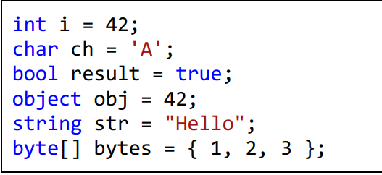
Example

Slide 25
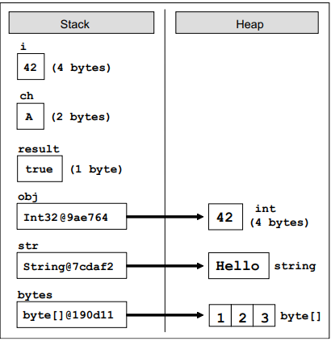

Slide 26
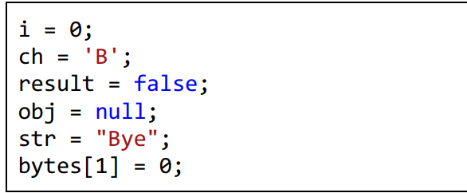
Changes made to the variables

Slide 27
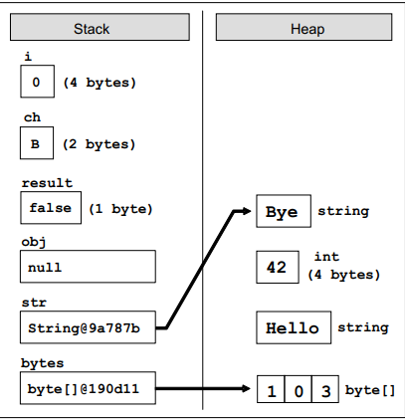

Slide 28

Making data constant
When you add the keyword const to a declaration, it becomes a constant.
const forces the functionality of not allowing the value to be changed.

Slide 29
Type conversion in C#
boxing vs unboxing
implicit vs explicit casting
using helper classes

Slide 30
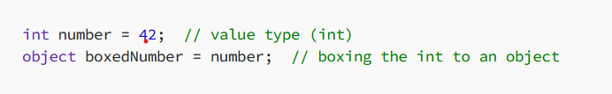
Boxing
Boxing refers to the process of converting a value type (such as int, char, bool, or double) into a reference type.
In languages like C# and Java, this is essential when dealing with collections or situations where reference types are expected.
When a value type is boxed, a new object is created on the heap, and the value is stored within it.
Consider the following example in C#:

Slide 31
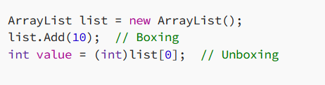
When do we need boxing?
Collections (Pre-Generics)
Collections are reference types, adding value types to collections is boxing
collections like ArrayList only stored objects. This meant that every value type you added to the collection was boxed.

Slide 32
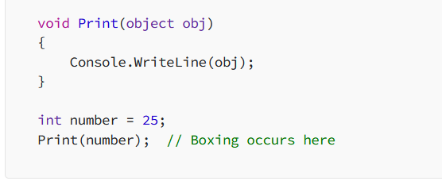
Cont,
Passing Value Types as Objects
You might need to box a value type if you’re passing it to a method that accepts an object parameter.

Slide 33
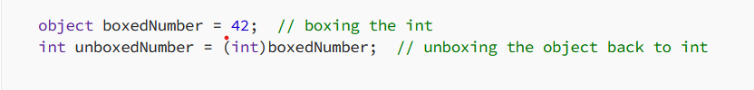
Unboxing
Unboxing is the reverse process of boxing, converting a reference type back into a value type.
This is necessary when extracting a value from a collection or object where it was previously boxed.
When you unbox, you’re extracting the value type from the reference type.
But be careful — when unboxing, you need to make sure that the object actually contains a value of the correct type.
Remember that, unboxing can lead to runtime errors if the types do not match.

Slide 34
C# - Type Conversion
Type conversion is converting one type of data to another type. It is also known as Type Casting.
In C#, type casting has two forms(Implicit and explicit)
Implicit type conversion
These conversions are performed by C# in a type-safe manner:
Example: conversions from smaller to larger integral types and conversions from derived classes to base classes.
It makes sure that no data loss occurs while converting from one type to another.
int x = 5;
double bigger = x;

Slide 35
Cont.
From derived class to base class
ChildClass child = new ChildClass();
BaseClass base = child;
Explicit type conversion(data loss may occur)
These conversions are done explicitly by users using the pre-defined functions.
Explicit conversions require a cast operator(parenthesis).
double d= 56.7;
int i= (int)d; //from higher precision to lower precision
From baseclass to derived class
ChildClass c1 = new ChildClass();
c1 = (ChildClass)base;

Slide 36
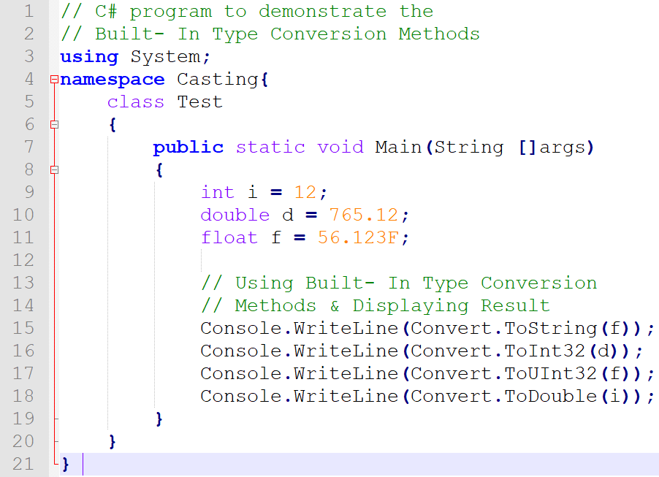
Using Helper class : Convert

Slide 37
C# -Operators and Expressions
Operators: perform an operation performed over data at runtime
Takes one or more arguments (operands)
Produces a new value
Operators have precedence
Precedence defines which will be evaluated first
Expressions: are sequences of operators and operands that are evaluated to a single value.
Int a = 4, b = 5;
Int c = a+b;

Slide 38
Operators in C# can be three type
Unary – take one operand
Binary – take two operands
Ternary – (?:) – takes three operands
Except for the assignment operators, all binary operators are left –associative
The assignment operators and the conditional operator (?:) are right associative

Slide 39
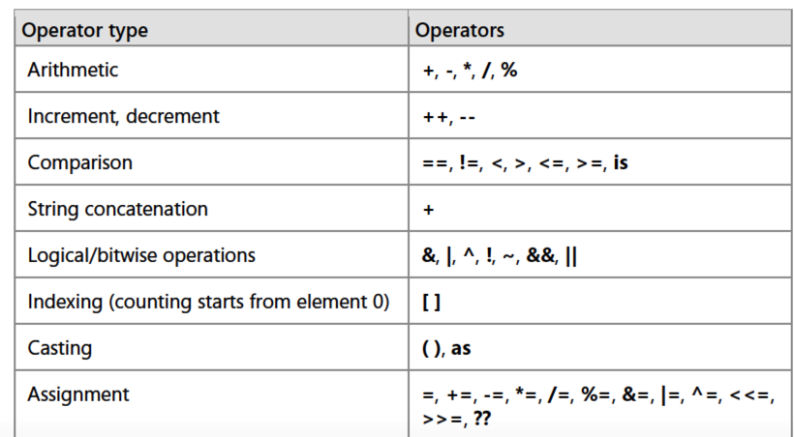

Slide 40
Making statements in a program

Slide 41
Statements in a program
A statement can consist of a single line of code that ends in a semicolon, or a series of single-line statements in a block.
A statement block is enclosed in {} brackets and can contain nested blocks.
Example
int counter;
counter=1;
Counter +1 ; // Error

Slide 42
Control Statements
If-else statements
Tests the condition: It executes the if block if condition is true otherwise else block is executed.
Syntax
if(condition){
//code if condition is true
}
else{
//code if condition is false
}

Slide 43
Dangling else problem
What is the output of the following code? When x=4;
if ( x % 2 == 0)
if ( x < 0 )
Console.WriteLine(x + “is an even, negative number“);
else
Console.WriteLine(x + " is an odd number“);
How to fix?

Slide 44
Switch Statements
Switch statements
A switch statement allows a variable to be tested for equality against a list of values.
Each value is called a case, and the variable being switched on is checked for each switch case.
Syntax
switch(expression) {
case constant-expression :
statement(s);
break;
/* you can have any number of case statements */
default : /* Optional */
statement(s);
break;
}

Slide 45
Loops Statements
A loop statement allows us to execute a statement or a group of statements multiple times.
When execution leaves a scope, all automatic objects that were created in that scope are destroyed.
Points to remember
The for loop has three steps: initialization, condition and increment/decrement.
In while loop, the initialization should be done before the loop starts and increment or decrement steps should be inside the loop.
do...while loop is guaranteed to execute at least one time
nested for loop is allowed in C#.

Slide 46
Iteration Statement Facts
Iteration statements are used to create loops in the flow of execution of a program.
The body of an iteration statement is a single statement or a code block.
The test expression of every iteration statement, except foreach, is a boolean expression.

Slide 47
Cont.
For Loop: Syntax
for ( init; condition; increment )
{ statement(s); }
While Loop: Syntax
while(boolean expression)
{
//execute code as long as condition
//returns true
}
Do while Loop: Syntax
do {
statement(s);
} while( condition );

Slide 48
break vs continue
The break statement
The break statement in C# has following two usage −
When the break statement is encountered inside a loop, the loop is immediately terminated and program control resumes at the next statement following the loop.
It can be used to terminate a case in the switch statement.
The continue statement
The continue statement in C# works somewhat like the break statement. Instead of forcing termination, however, continue forces the next iteration of the loop to take place, skipping any code in between.

Slide 49
foreach statements(Mostly used for reading data elements)
Iteration of user-defined collections
Iterate over all elements of an array or other collections of elements (IEnumerable)
Syntax
foreach ( type_variable in collection)
{ statement(s); }
Example
int [ ] numbers = { 2, 3, 5, 7, 11, 13, 17, 19 };
foreach (int i in numbers)
{
Console.Write(" " + i);
}
Output
2 3 5 7 11 13 17 19

Slide 50
Exercises -: Bad loops
Write the output of the following loop statements
for (int i = 10; i < 5; i=i+1)
{
Console.WriteLine("How many times do I print?");
}
for (int i = 10; i >= 1; i=i+1)
{
Console.WriteLine("How many times do I print?");
}

Slide 51
Note: Loops that test for a boolean condition must include some mechanism within the body for setting the expression to false.
If the condition always evaluates to true, the result will be an infinite loop.
Following are some examples of code that result in an infinite loop:
while(true) { }
for(;;) { }
do{}while(true);

Slide 52
Arrays in C#

Slide 53
Working with Arrays
As you study this section, answer the following questions:
Which array type is equivalent to a table with columns and rows?
Which array type is a collection of objects?
What number is used to access the first element in an array?
What type of values can be stored in an array? Can an array hold more than one type of value?

Slide 54
Array Facts
An array is a group of contiguous memory locations that all have the same name and type.
Arrays are reference-type objects that hold a set of related data, much like a list of data or a table.
The following table describes two simple array types.

Slide 55
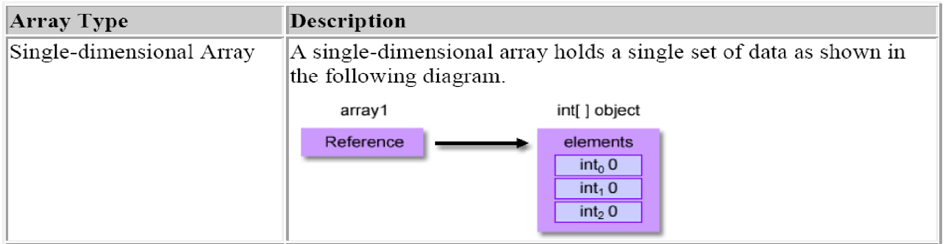
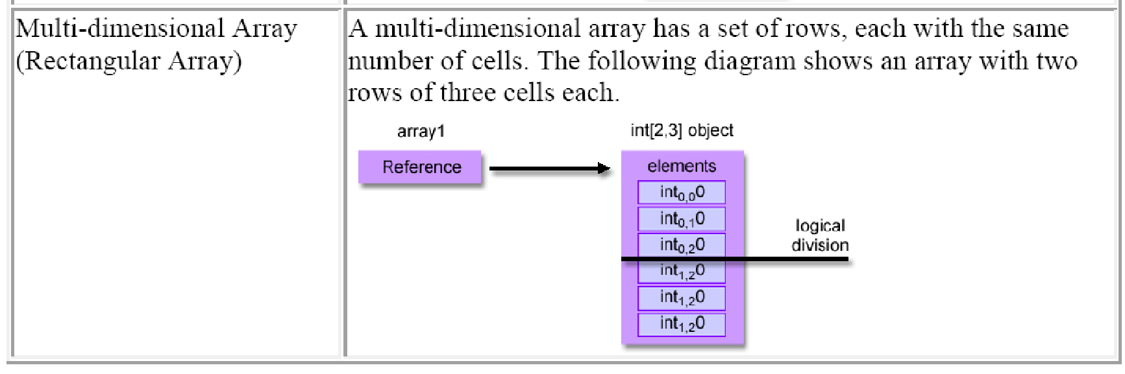

Slide 56
All elements in an array must be of the same type.
When you declare an array, you begin by defining the data type, the number of elements in the array, and the array name.
The following table compares various methods for declaring and initializing arrays.

Slide 57
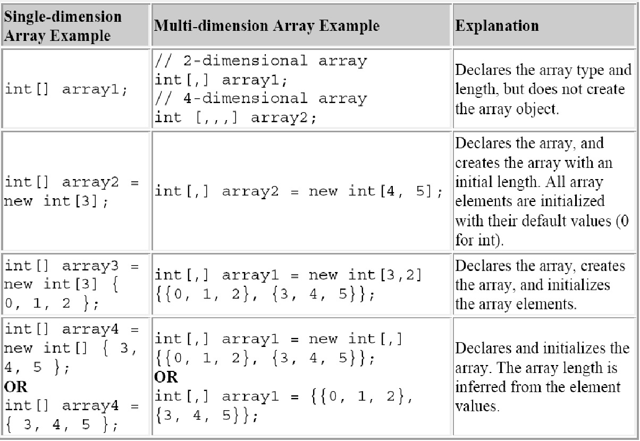

Slide 58
Array initializers
Just as you use compile-time initialization with variables, you can initialize the elements of an array during declaration. The general form of the initialization follows:
int [ ] anArray = {100, 200, 400, 600}; char [ ] grade = new char[ ] {'A', 'B', 'C', 'D', 'F'}; double [ ] depth = new double[2] {2.5, 3};

Slide 59
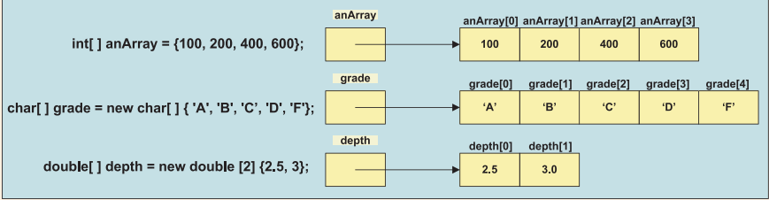
Memory allocation of array elements
Accessing an array is done by specifying the identifier and the index of the array in square brackets.
grade[0]//accessing the first element
grade[4]//accessing the fourth element

Slide 60
Cont.
The score array with 14 element can be summed in the following two manners.
total = score[0] + score[1] + score[2] + score[3] + score[4] + score[5] + score[6] + score[7] + score[8] + score[9] + score[10] + score[11] + score[12] + score[13];
Better way to sum values in the score array
for (int i = 0; i < score.Length; i++) { total += score[i]; }

Slide 61
Using foreach with arrays
The foreach loop can be used to iterate through an array. However, it can be used for read-only access to the elements.
The foreach loop cannot be used to change the contents of any of the elements in an array.
It is designed to only iterate through collections, making sure every item in the array is visited.
Int total =0;
foreach(int val in score) { total += val; } WriteLine("Total: " + total);

Slide 62
Methods in the Array Class
BinarySearch(System.Array array, object value) – searches a sorted one dimensional array using binary searching algorithm and returns the index of the item or negative value if item is not found
double [ ] waterDepth = {2.4, 3.5, 6.8};
double x = 6.8;
int myIndex = Array.BinarySearch(waterDepth, x);
Console.WriteLine(myIndex); //returns 2

Slide 63
Cont.
Array.Clear() Class method – sets elements of the array to zero, false or null depending upon the base type of the array.
Start at first position go length position.
char[] grade = {'A','B','C','A'};
Array.Clear(grade,0,2);
for(int i=0; i<grade.Length; i++){
Console.Write(grade[i]); } //sets grade[0] and grade[1] to null.

Slide 64
Cont.
Array.Reverse(System.Array array)- reverses the order of one dimensional array or in a portion of the array.
Array.Reverse(grade);
for(int i=0; i<grade.Length; i++){
Console.Write(grade[i]); } //ACBA

Slide 65
Multidimensional Arrays

Slide 66
Two dimensional rectangular arrays
A rectangular two-dimensional array is usually visualized as a table divided into rows and columns.
Much like a spreadsheet in which the rows and columns intersect, data is stored in individual cells. Declaring a rectangular array
Two integral values are required for a two-dimensional array.
These values specify the number of rows and columns for allocating storage to be referenced by the identifier name.

Slide 67
Cont.
int [ , ] calories = new int[2, 3];
This allocates storage for 6 elements.
The first index represents the number of rows; the second represents the number of columns.
Notice how a comma is used as a separator between the row and the column for both the declaration base type and again to separate the number of rows and columns.
Declare a rectangular array that is 7x3. How many elements is contained in the array?

Slide 68
int [ , ] calories = { {900, 750, 1020}, {300, 1000, 2700}, {500, 700, 2100}, {400, 900, 1780}, {600, 1200, 1100}, {575, 1150, 1900}, {600, 1020, 1700} };
C# is a row major language, meaning that data is stored in contiguous memory locations by row.
All elements from row 0 are placed in memory first followed by all elements from row 1, and so on.

Slide 69
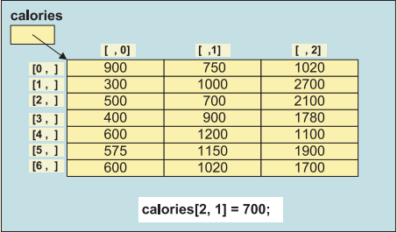
Cont.
Pictorial representation of calories rectangular array.

Slide 70
Cont.
Traversing through a 2D array.
for (int r = 0; r < calories.GetLength(0); r++){ for (int c = 0; c < calories.GetLength(1); c++){ calories[r, c] = 0;
}
}
GetLength(0) returns the number of rows
GetLength(1) returns the number of columns

Slide 71
Jagged Array
When the number of columns in the rows must differ, a jagged, or ragged array, can be created.
Jagged arrays are called “arrays of arrays.” One row might have five columns; another row 50 columns.
To create a jagged array, you can create a one-dimensional array of type Array and initialize each of the onedimensional arrays separately.

Slide 72
Cont.
int[ ] [ ] anArray = new int[4] [ ]; anArray[0] = new int[ ] {100, 200}; anArray[1] = new int[ ] {11, 22, 37}; anArray[2] = new int[ ] {16, 72, 83, 99, 106, 42, 87}; anArray[3] = new int[ ] {1, 2, 3, 4};
100 | 200
11 | 22 | 37
16 | 72 | 83 | 99 | 106 | 42
1 | 2 | 3 | a

Slide 73
Cont.
Traversing through a jagged array
Console.WriteLine(myarray.Length);
Console.WriteLine(myarray[2].Length);
for (int i = 0; i < myarray.Length; i++)
{
for (int j = 0; j < myarray[i].Length; j++)
{
Console.Write($"{myarray[i][j]} |"); }
Console.WriteLine();

Slide 74
Cont.
Keep in mind the following facts about arrays:
Arrays are reference-type objects (even if they hold value-types).
The array can be declared as any type (even a reference type).
All elements of an array must be of (or inherit from) the same type.
Element access in an array is zero-based. The first element has an index number of 0.
All rows in a rectangular array must be of the same size.
Rectangular arrays can be of any dimension (2, 3, 4, or more).
Arrays are bounds-checked, meaning that you cannot access elements outside of the array. Attempts to access elements outside of the bounds of the array will result in a runtime error (called an exception).

Slide 75
ArrayLists in C#
ArrayList is a class in C# that belongs to System.Collections namespace.
In C#, the ArrayList is a non-generic collection of objects whose size increases dynamically.
It differs from Array in two ways
It can hold hetrogenous values
Its size can increase dynamically
You can use an arraylist when you are working with unknown data, where you do not know the type and size of the data elements.

Slide 76
Methods in Arraylist
Initialize an ArrayList
ArrayList s_info = new ArrayList();
Add() - adds items to the collection
s_info.Add("Ruhame");
s_info.Add(21);
s_info.Add(1.70);
Sort() - sorts the given ArrayList
RemoveAt() - removes ArrayList item at the specified index
s_info.RemoveAt(0);
Clear - clears all elements of an array
s_info.Clear();

Slide 77
Characters in C#
C# provides a data type, called a structure, that is similar to a class.
Although structures and classes are comparable in many ways, structures are a value type.
Like classes, structures include methods and properties. Both use the same modifiers (such as public, private and protected) and access members via the member access operator (.).
Most primitive data types are of structure type including char
Char is a structure for characters.
Most Char methods are static, take at least one character argument and perform either a test or a manipulation on the character.
See the following example

Slide 78
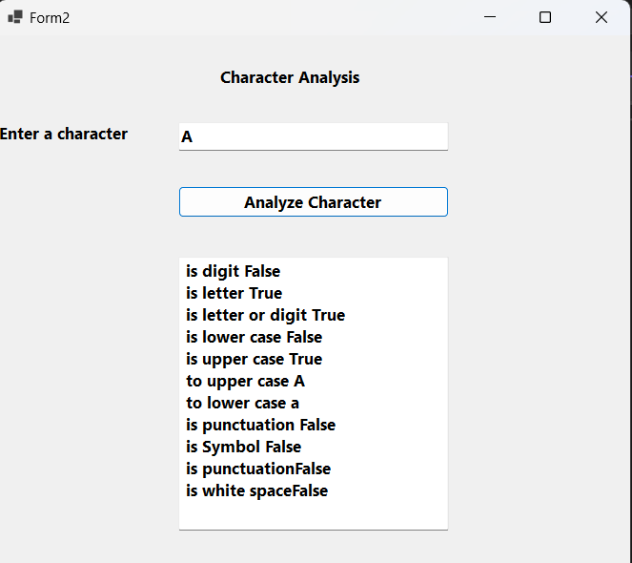
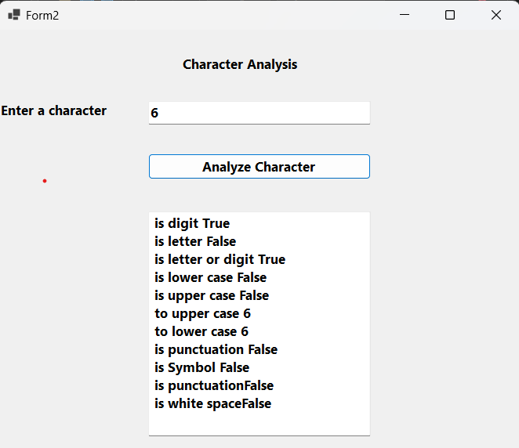
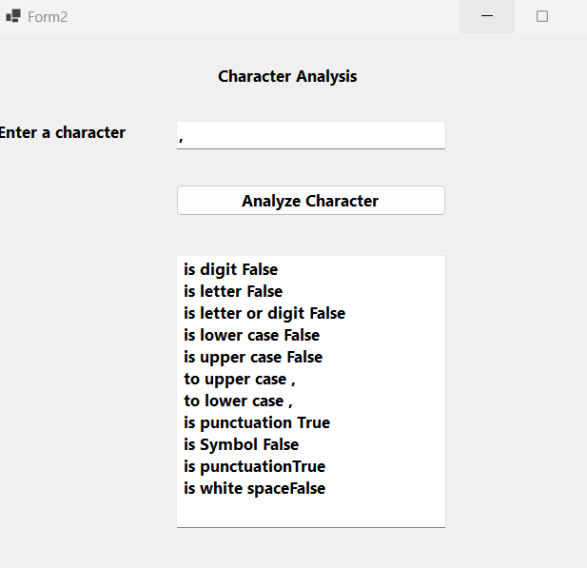

Slide 79
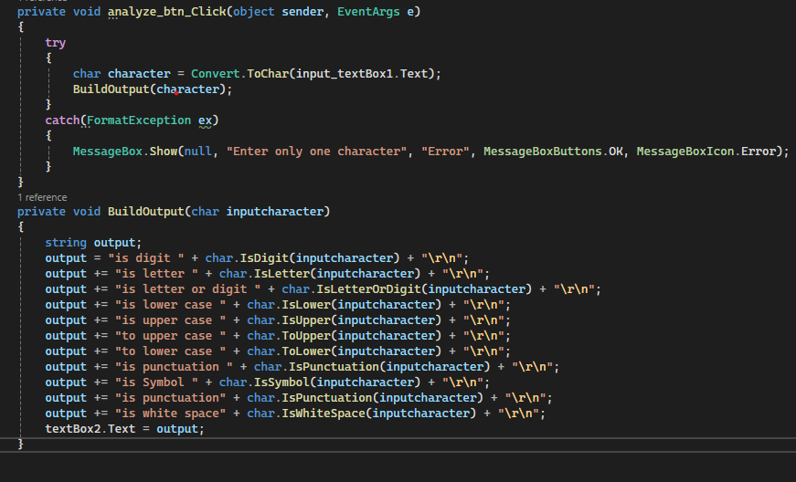

Slide 80
How the character analysis program works
This Windows application contains a prompt, a TextBox into which the user can input a character, a button that the user can press after entering a character and a second TextBox that displays the output of our analysis.
When the user clicks the Analyze Character button, event handler analyzeButton_Click() is invoked
This method converts the entered data from a string to a Char, using method Convert.ToChar()
we call method BuildOutput(),
Char method IsDigit to determine whether character inputCharacter is defined as a digit.
If so, the method returns true; otherwise, it returns false.
Char method IsLetter to determine whether character inputCharacter is a letter.

Slide 81
How the character analysis program works
This Windows application contains a prompt, a TextBox into which the user can input a character, a button that the user can press after entering a character and a second TextBox that displays the output of our analysis.
When the user clicks the Analyze Character button, event handler analyzeButton_Click() is invoked
This method converts the entered data from a string to a Char, using method Convert.ToChar()
we call method BuildOutput(),
Char method IsDigit to determine whether character inputCharacter is defined as a digit.
If so, the method returns true; otherwise, it returns false.
Char method IsLetter to determine whether character inputCharacter is a letter.

Slide 82
Exercise
Write algorithms to solve the following problems.
Narcissistic Numbers: An n digit number is narcissistic number that is the sum of its own digits each raised to the power of the number of digits.
E.g 153 -> 1^(3) + 5^(3) +3^(3) = 153
Palindrome checker: a word, phrase, or sequence that reads the same backwards as forwards, e.g. madam or nurses run.
Rock paper scissors: ROCK PAPER SCISSORS is a traditional two-player game. Each round, players begin by saying, “rock, paper, scissors, shoot!” Each player holds their fist for the rock, flat hand for the paper, or index and middle finger for scissors on “shoot.” The rock crushes the scissors, the scissors cut the paper, and the paper covers the rock.
Convert decimal number to binary.

Slide 83
Cont.
Reading assignment
What is a garbage collector? How does it work? Why is it needed?
Read on how to use the Parse helper class for converting from one data type to another.

